Slide 1

Fnu Gaurav
DATA SCIENCE CAPSTONE PROJECT

Slide 2


OUTLINE
•
•
•
•
•
•

Slide 3

Summary of methodologies
EXECUTIVE SUMMARY
Data collection
Data wrangling
Exploratory Data Analysis with Data Visualization
Exploratory Data Analysis with SQL
Building an interactive map with Folium
Building a Dashboard with Plotly Dash
Predictive analysis (Classification)
Summary of all results
Exploratory Data Analysis results
Interactive analytics demo in screenshots
Predictive analysis results

Slide 4

Project background and context
INTRODUCTION
SpaceX is the most successful company of the commercial space age, making space travel affordable. The company advertises Falcon 9 rocket launches on its website, with a cost of 62 million dollars; other providers cost upward of 165 million dollars each, much of the savings is because SpaceX can reuse the first stage. Therefore, if we can determine if the first stage will land, we can determine the cost of a launch. Based on public information and machine learning models, we are going to predict if SpaceX will reuse the first stage.
Questions to be answered
How do variables such as payload mass, launch site, number of
flights, and orbits affect the success of the first stage landing?
Does the rate of successful landings increase over the years?
What is the best algorithm that can be used for binary classification in this case?

Slide 5

METHODOLOGY
Data collection methodology:
Using SpaceX Rest API
Using Web Scrapping from Wikipedia
Performed data wrangling
Filtering the data
Dealing with missing values
Using One Hot Encoding to prepare the data to a binary classification
Performed exploratory data analysis (EDA) using visualization and SQL Performed interactive visual analytics using Folium and Plotly Dash Performed predictive analysis using classification models
Building, tuning and evaluation of classification models to ensure the best results

Slide 6
METHODOLOGY

Slide 7
Data collection process involved a combination of API requests from SpaceX REST API and Web Scraping data from a table in SpaceX’s Wikipedia entry.
DATA COLLECTION
We had to use both of these data collection methods in order to get complete information about the launches for a more detailed analysis.
Data Columns are obtained by using SpaceX REST API:
FlightNumber, Date, BoosterVersion, PayloadMass, Orbit, LaunchSite, Outcome, Flights, GridFins, Reused, Legs, LandingPad, Block, ReusedCount, Serial, Longitude, Latitude
Data Columns are obtained by using Wikipedia Web Scraping:
Flight No., Launch site, Payload, PayloadMass, Orbit, Customer, Launch outcome, Version Booster, Booster landing, Date, Time

Slide 8
Data Collection (SpaceX API)
Decoding the response content using .json() and turning it into a dataframe using
.json_normalize()
Requesting needed information about the launches from SpaceX API
by applying custom functions
Requesting rocket launch data from SpaceX API
Constructing data we have obtained into a dictionary
Replacing missing values of Payload Mass column with calculated .mean() for this column
Filtering the dataframe to only include Falcon 9 launches
Exporting the data to CSV
Creating a dataframe from the dictionary

Slide 9
Data Collection – WebScraping
Requesting Falcon 9 launch data from Wikipedia
Creating a BeautifulSoup object from the HTML response
Extracting
all column names from the HTML table header
Collecting the data by parsing HTML tables
Exporting the data to CSV
Creating a dataframe from the dictionary
Constructing data we have obtained into a dictionary

Slide 10
Data Wrangling
In the data set, there are several different cases where the booster did not land successfully. Sometimes a landing was attempted but failed due to an accident; for example, True Ocean means the mission outcome was successfully landed to a specific region of the ocean while False Ocean means the mission outcome was unsuccessfully landed to a specific region of the ocean. True RTLS means the mission outcome was successfully landed to a ground pad False RTLS means the mission outcome was unsuccessfully landed to a ground pad.True ASDS means the mission outcome was successfully landed on a drone ship False ASDS means the mission outcome was unsuccessfully landed on a drone ship.
We mainly convert those outcomes into Training Labels with “1” means the booster successfully landed, “0” means it was unsuccessful.
Perform exploratory Data Analysis and determine Training Labels
Calculate the number of launches on each site
Calculate the number and occurrence of each orbit
Calculate the number and occurrence of mission outcome per orbit type
Create a landing outcome label from Outcome column
Exporting the data to CSV

Slide 11
Charts were plotted:
EDA with Data Visualization
Flight Number vs. Payload Mass, Flight Number vs. Launch Site, Payload Mass vs. Launch Site, Orbit Type vs. Success Rate, Flight Number vs. Orbit Type, Payload Mass vs Orbit Type and Success Rate Yearly Trend
Scatter plots show the relationship between variables. If a relationship exists, they could be used in machine learning model.
Bar charts show comparisons among discrete categories. The goal is to show the relationship between the specific categories being compared and a measured value.
Line charts show trends in data over time (time series).

Slide 12
EDA with SQL
Performed SQL queries:
Displaying the names of the unique launch sites in the space mission
Displaying 5 records where launch sites begin with the string ‘CCA'
Displaying the total payload mass carried by boosters launched by NASA (CRS)
Displaying average payload mass carried by booster version F9 v1.1
Listing the date when the first successful landing outcome in ground pad was achieved
Listing the names of the boosters which have success in drone ship and have payload mass greater than 4000 but less than 6000
Listing the total number of successful and failure mission outcomes
Listing the names of the booster versions which have carried the maximum payload mass
Listing the failed landing outcomes in drone ship, their booster versions and launch site names for the months in year 2015
Ranking the count of landing outcomes (such as Failure (drone ship) or Success (ground pad)) between the date 2010-06-04 and 2017-03-20 in descending order

Slide 13
Markers of all Launch Sites:
Interactive Visual with Folium
Added Marker with Circle, Popup Label and Text Label of NASA Johnson Space Center using its latitude and longitude coordinates as a start location.
Added Markers with Circle, Popup Label and Text Label of all Launch Sites using their latitude and longitude coordinates to show their geographical locations and proximity to Equator and coasts.
Coloured Markers of the launch outcomes for each Launch Site:
Added coloured Markers of success (Green) and failed (Red) launches using Marker Cluster to identify which launch sites have relatively high success rates.
Distances between a Launch Site to its proximities:
Added coloured Lines to show distances between the Launch Site KSC LC-39A (as an example) and its proximities like Railway, Highway, Coastline and Closest City.

Slide 14
Launch Sites Dropdown List:
Dashboard with Plotly Dash
Added a dropdown list to enable Launch Site selection.
Pie Chart showing Success Launches (All Sites/Certain Site):
Added a pie chart to show the total successful launches count for all sites and the Success vs. Failed counts for the site, if a specific Launch Site was selected.
Slider of Payload Mass Range:
Added a slider to select Payload range.
Scatter Chart of Payload Mass vs. Success Rate for the different Booster Versions:
Added a scatter chart to show the correlation between Payload and Launch Success.

Slide 15
Predictive Analysis (Classification)
Standardizing the data with StandardScaler, then fitting and transforming it
Splitting the data into training and testing sets with train_test_split function
Creating a GridSearchCV object with cv = 10 to find the best parameters
Creating a NumPy array from the column “Class” in data
Finding the method performs best by examining the Jaccard_score and F1_score metrics
Calculating the accuracy on the test data using the method .score()
for all models
Applying GridSearchCV on LogReg, SVM,
Decision Tree, and KNN models
Examining the confusion matrix for all models

Slide 16

RESULTS
•
•
•

Slide 17
EDA with Visualization

Slide 18
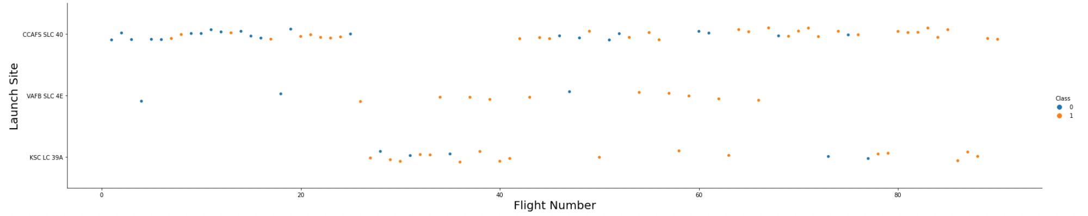
Flight number vs Launch Site
Explanation:
The earliest flights all failed while the latest flights all succeeded.
The CCAFS SLC 40 launch site has about a half of all launches.
VAFB SLC 4E and KSC LC 39A have higher success rates.
It can be assumed that each new launch has a higher rate of success.

Slide 19
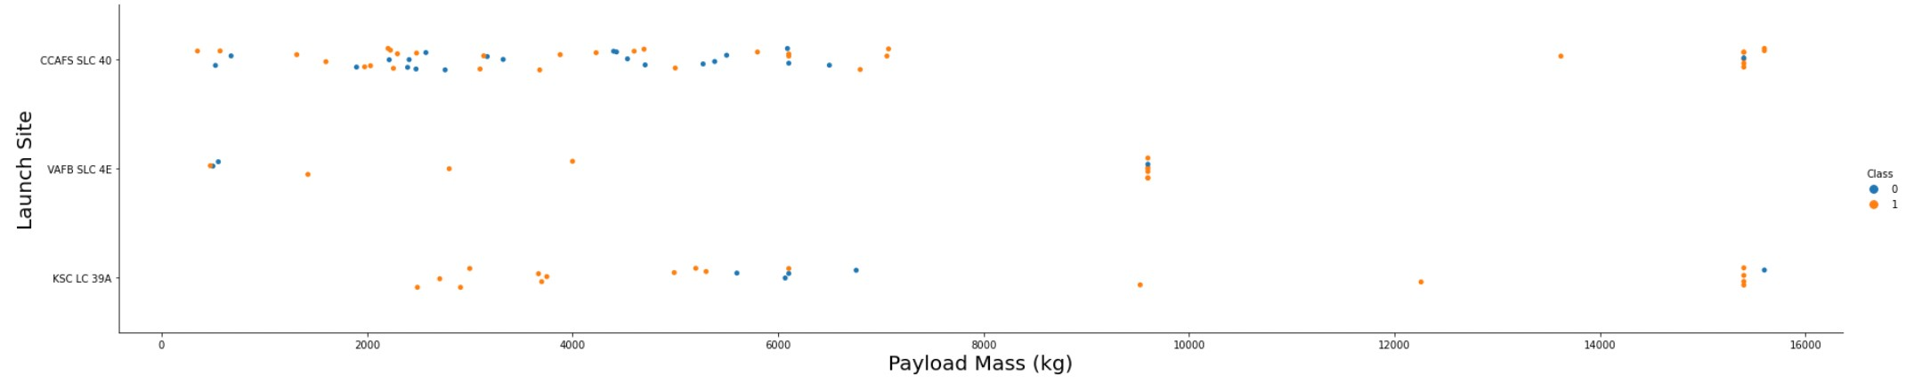
Payload vs Launchsite
Explanation:
For every launch site the higher the payload mass, the higher the success rate.
Most of the launches with payload mass over 7000 kg were successful.
KSC LC 39A has a 100% success rate for payload mass under 5500 kg too.

Slide 20
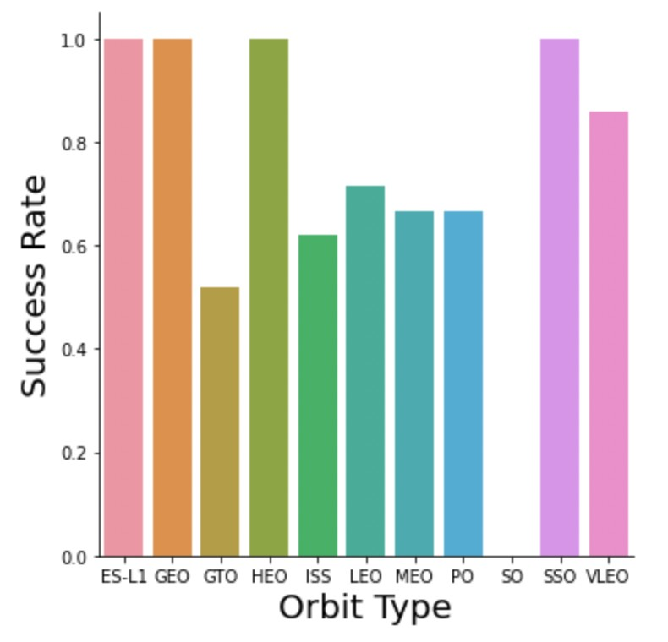
Explanation:
Success rate vs Orbit type
Orbits with 100% success rate:
ES-L1, GEO, HEO, SSO
Orbits with 0% success rate:
SO
Orbits with success rate between 50% and 85%:
GTO, ISS, LEO, MEO, PO

Slide 21
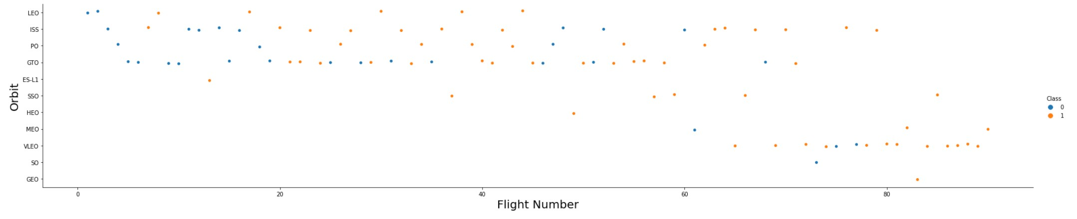
Flight Number vs Orbit type
Explanation:
In the LEO orbit the Success appears related to the number of flights; on the other hand, there seems to be no relationship between flight number when in GTO orbit.

Slide 22
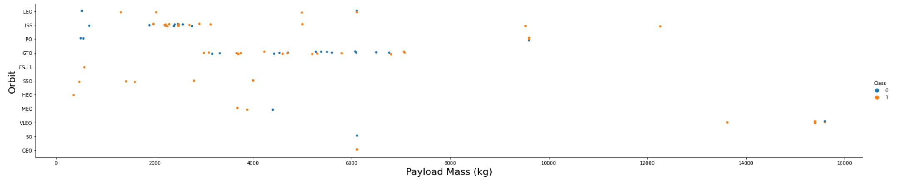
Payload Mass vs Orbit Type
Explanation:
Heavy payloads have a negative influence on GTO orbits and positive on GTO and Polar LEO (ISS) orbits.

Slide 23
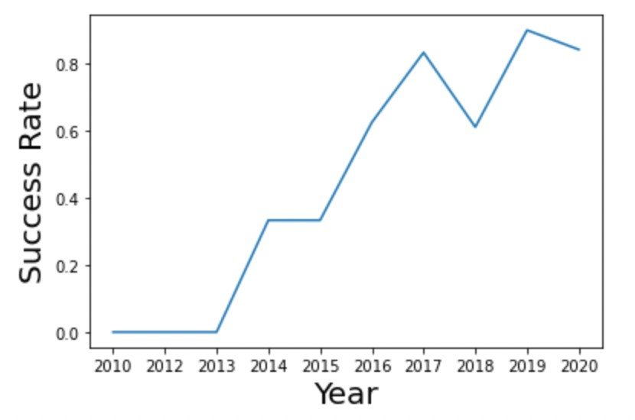
Explanation:
Launch Success Yearly Trend
The success rate since 2013 kept increasing till 2020.

Slide 24
EDA with SQL

Slide 25
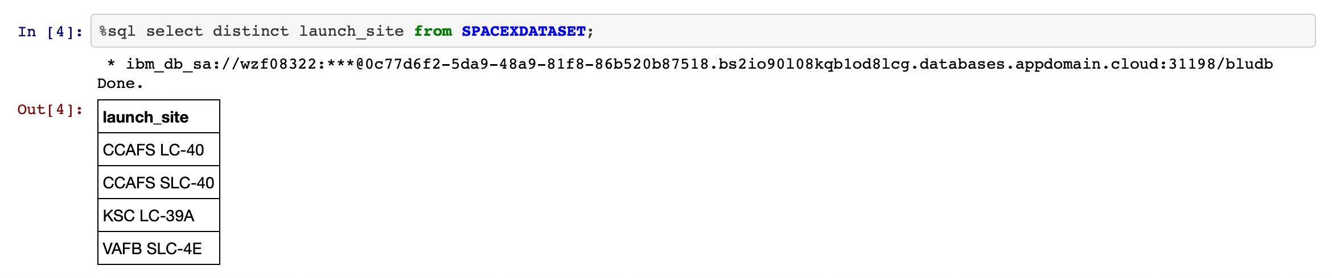
Launch Sites
Explanation:
Displaying the names of the unique launch sites in the space mission.

Slide 26
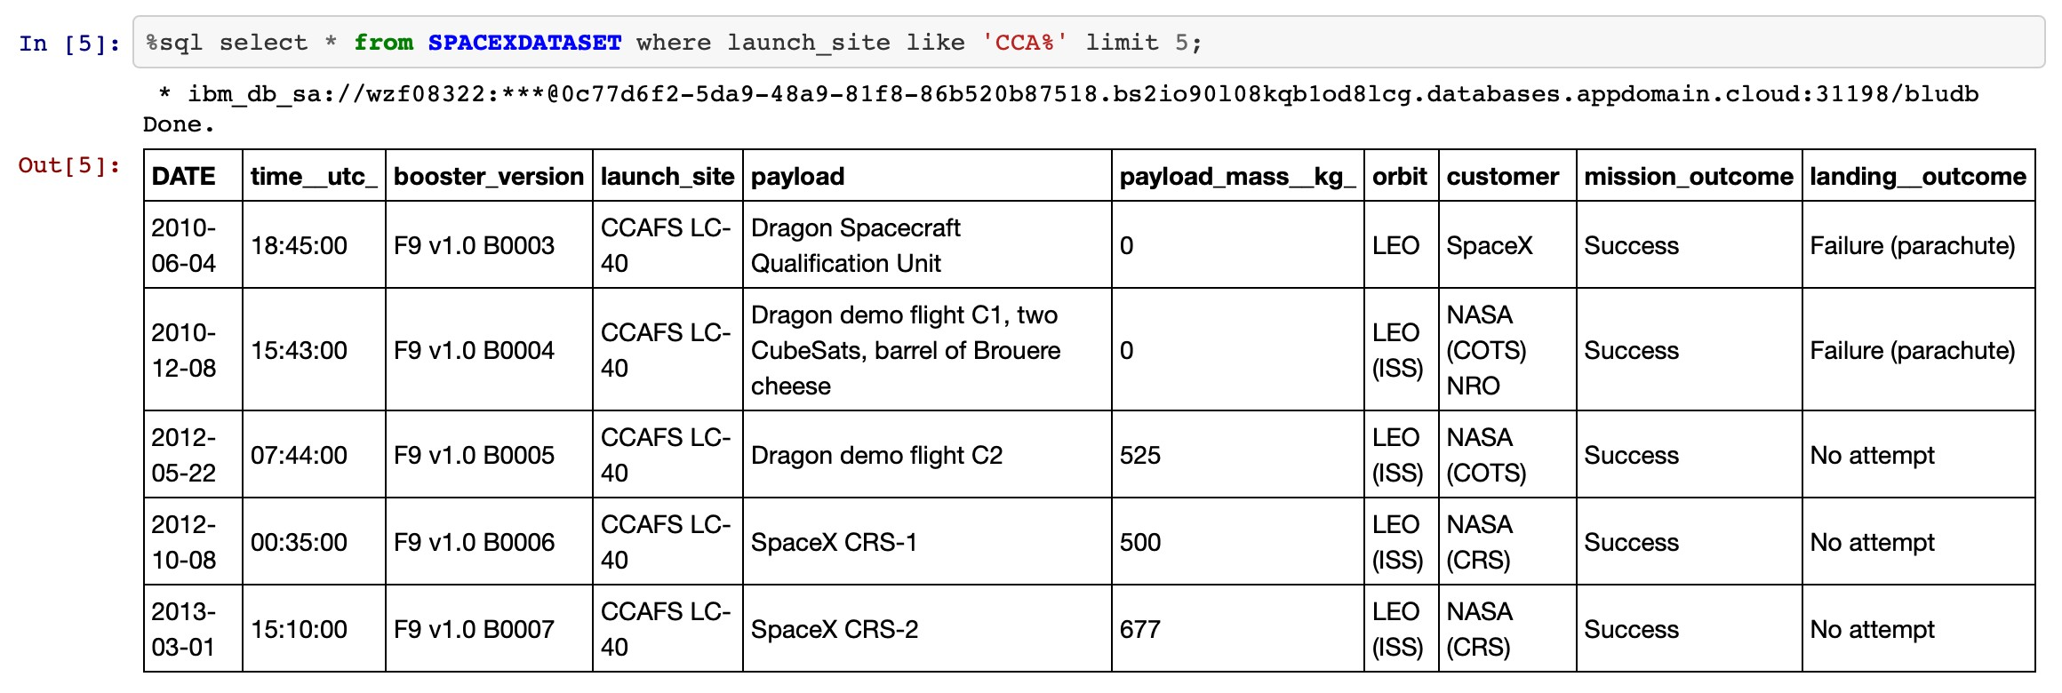
Launch site starting with CAA
Explanation:
Displaying 5 records where launch sites begin with the string 'CCA'.

Slide 27
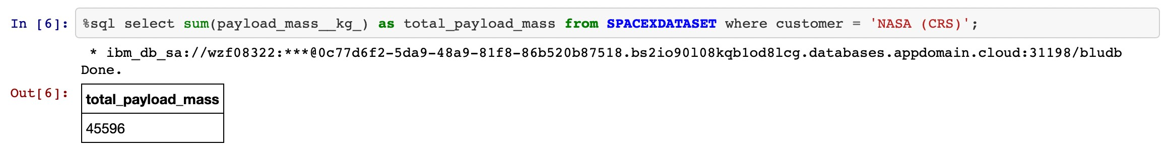
Total Payload Mass
Explanation:
Displaying the total payload mass carried by boosters launched by NASA (CRS).

Slide 28
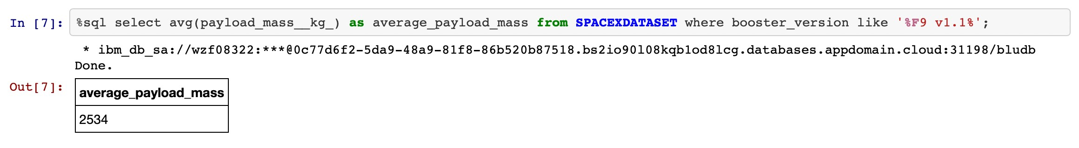
Average Payload Mass by F9 vs 1.1
Explanation:
Displaying average payload mass carried by booster version F9 v1.1.

Slide 29
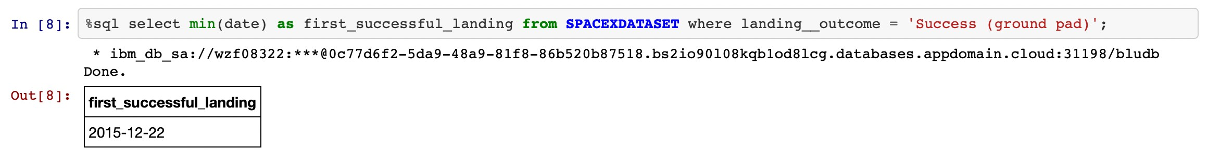
First Succesful landing date
Explanation:
Listing the date when the first successful landing outcome in ground pad was achieved.

Slide 30
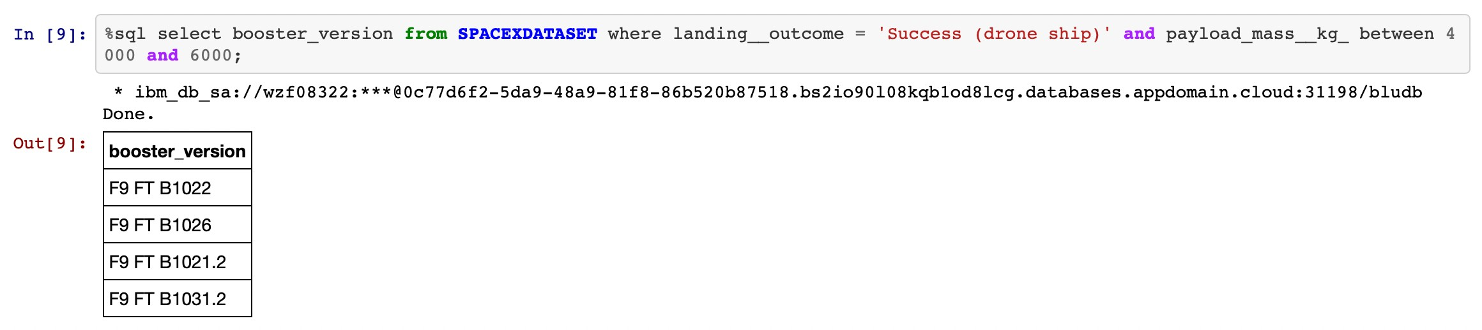
Successful landing with payload between 4000 - 6000
Explanation:
Listing the names of the boosters which have success in drone ship and have payload mass greater than 4000 but less than 6000.

Slide 31
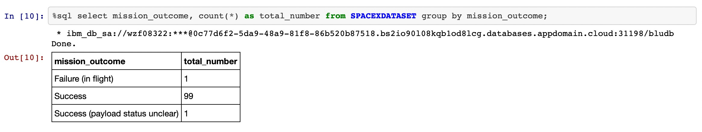
Total number of success and failed
Explanation:
Listing the total number of successful and failure mission outcomes.

Slide 32
Interactive map with Folium

Slide 33
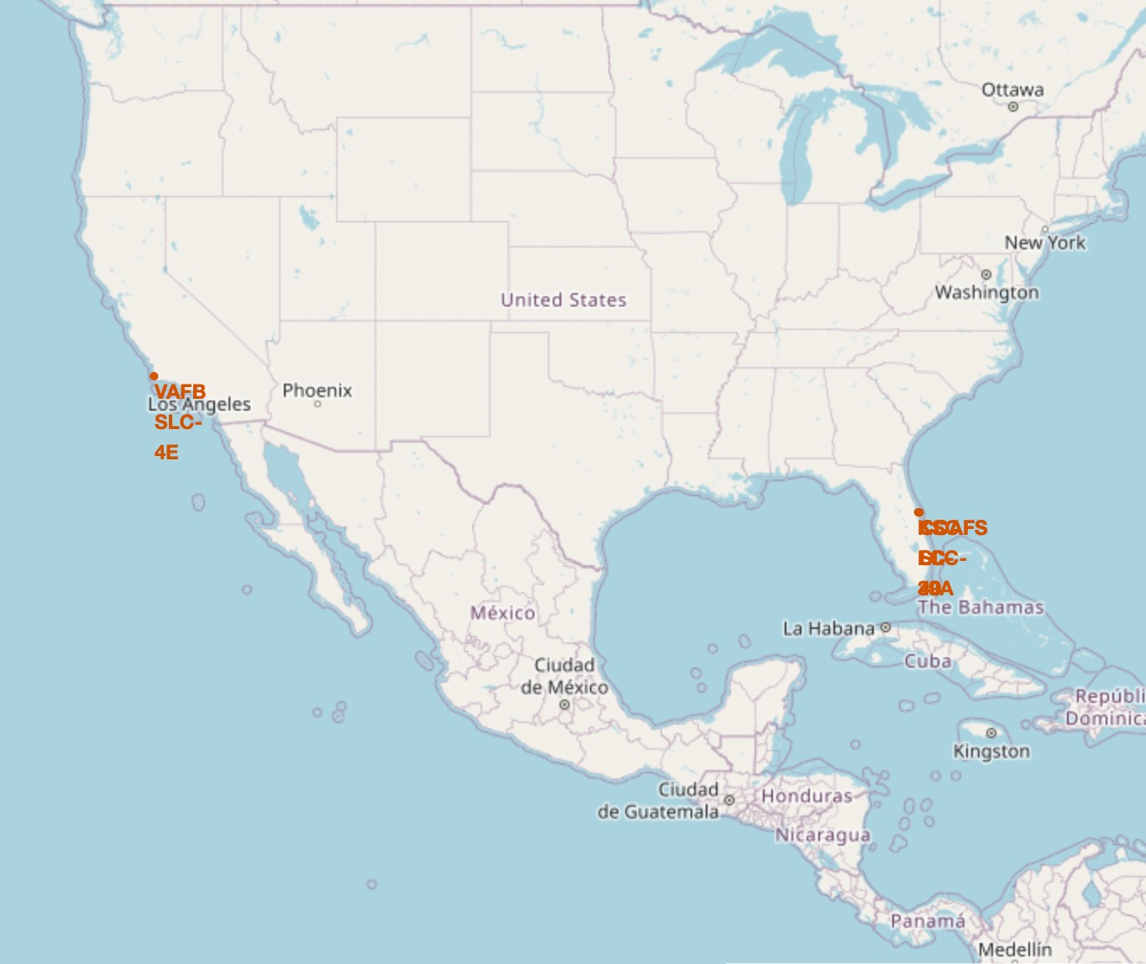
Location marker on map
Explanation:
Most of Launch sites are in proximity to the Equator line. The land is moving faster at the equator than any other place on the surface of the Earth. Anything on the surface of the Earth at the equator is already moving at 1670 km/hour. If a ship is launched from the equator it goes up into space, and it is also moving around the Earth at the same speed it was moving before launching. This is because of inertia. This speed will help the spacecraft keep up a good enough speed to stay in orbit.
All launch sites are in very close proximity to the coast, while launching rockets towards the ocean it minimises the risk of having any debris dropping or exploding near people.

Slide 34
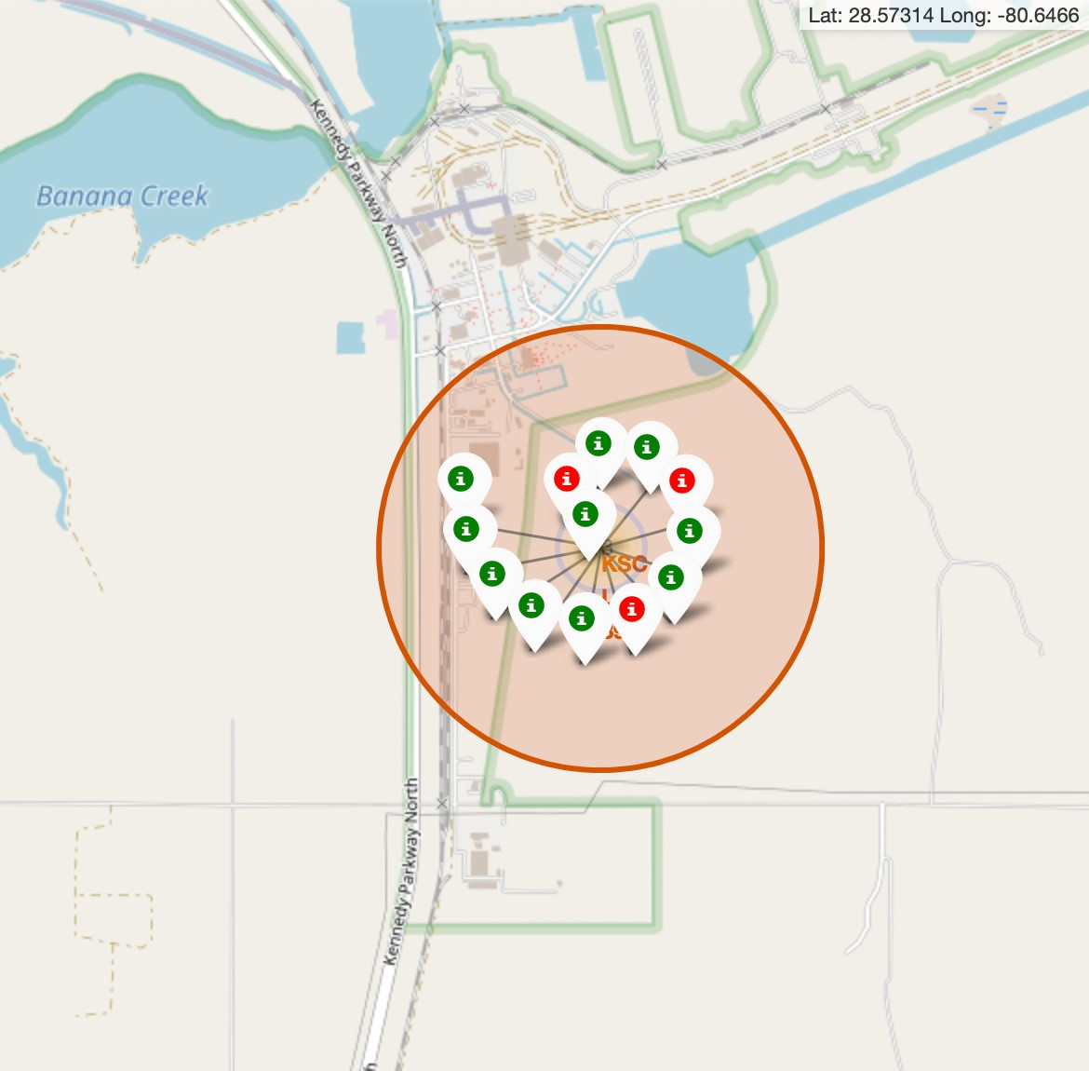
Explanation:
Color labeled launch record
From the colour-labeled markers we should be able to easily identify which launch sites have relatively high success rates.
Green Marker = Successful Launch
Red Marker = Failed Launch
Launch Site KSC LC-39A has a very high Success Rate.

Slide 35
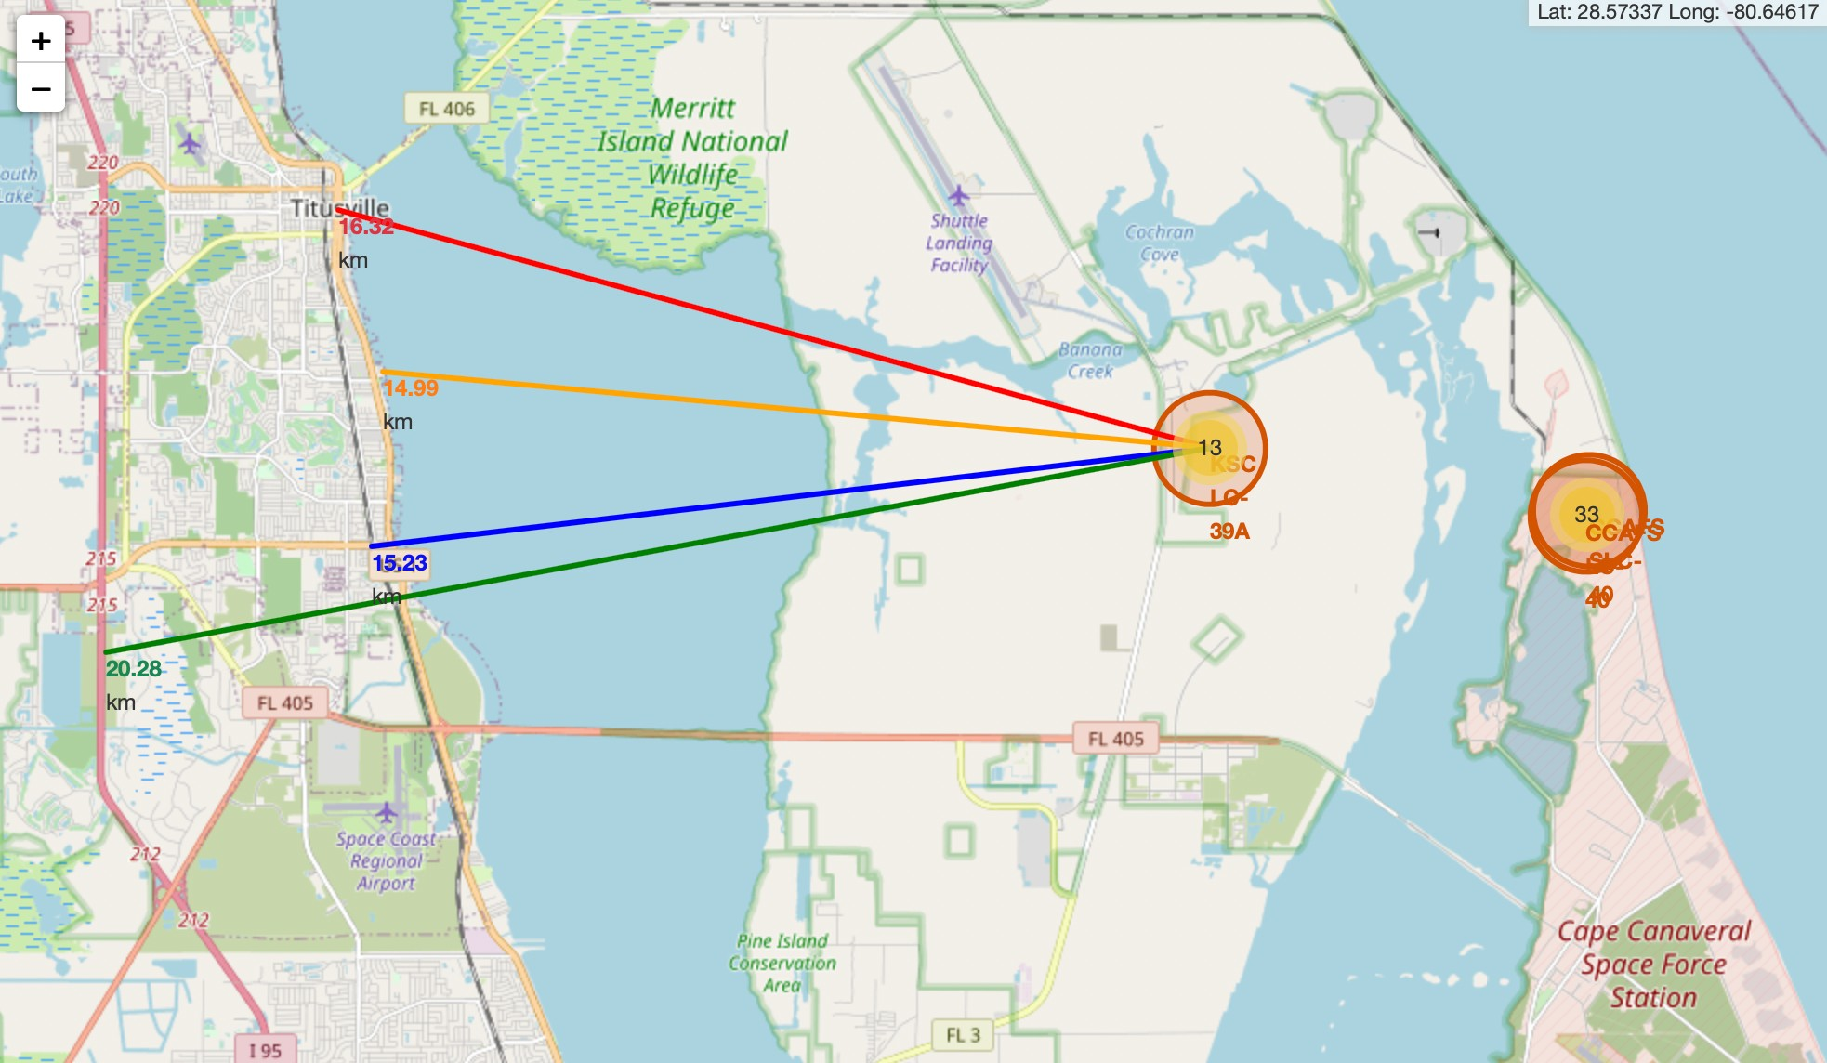
Distance from Launch Site
Explanation:
From the visual analysis of the launch site KSC LC-39A we can clearly see that it is:
relative close to railway (15.23 km)
relative close to highway (20.28 km)
relative close to coastline (14.99 km)
Also the launch site KSC LC-39A is relative close to its closest city Titusville (16.32 km).
Failed rocket with its high speed can cover distances like 15-20 km in few seconds. It could be potentially dangerous to populated areas.

Slide 36
Dashboard with Plotly Dash

Slide 37
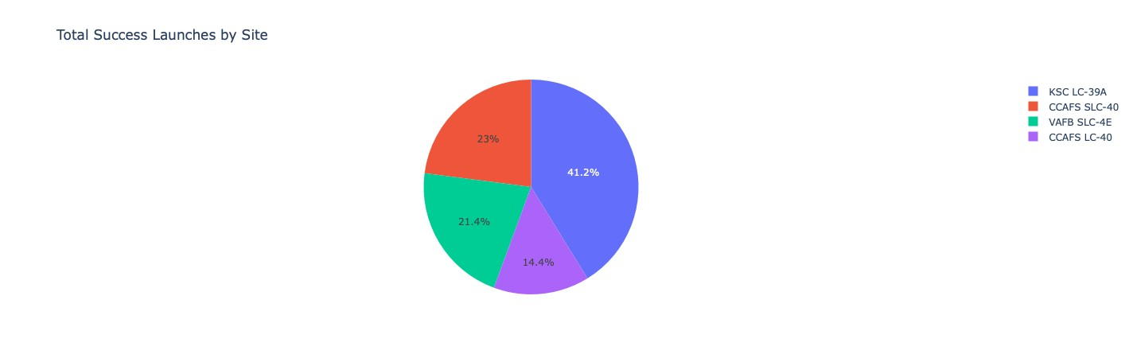
Launch Success count by sites
Explanation:
The chart clearly shows that from all the sites, KSC LC-39A has the most successful launches.

Slide 38
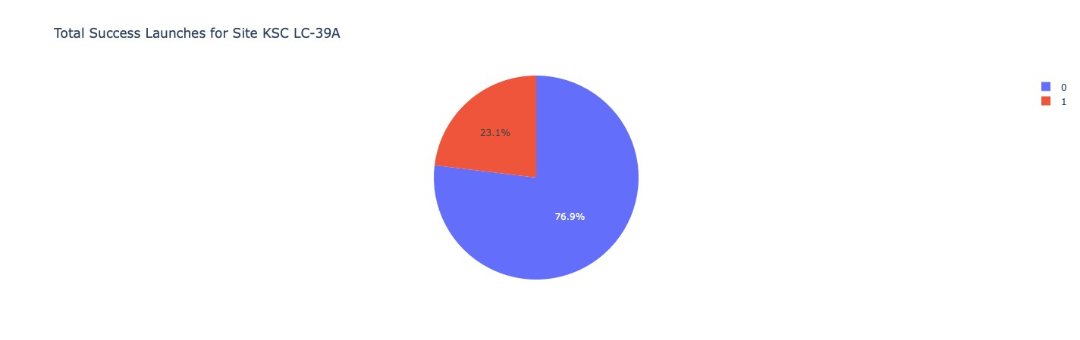
Launch site with highest success ratio
Explanation:
KSC LC-39A has the highest launch success rate (76.9%) with 10 successful and only 3 failed landings.

Slide 39
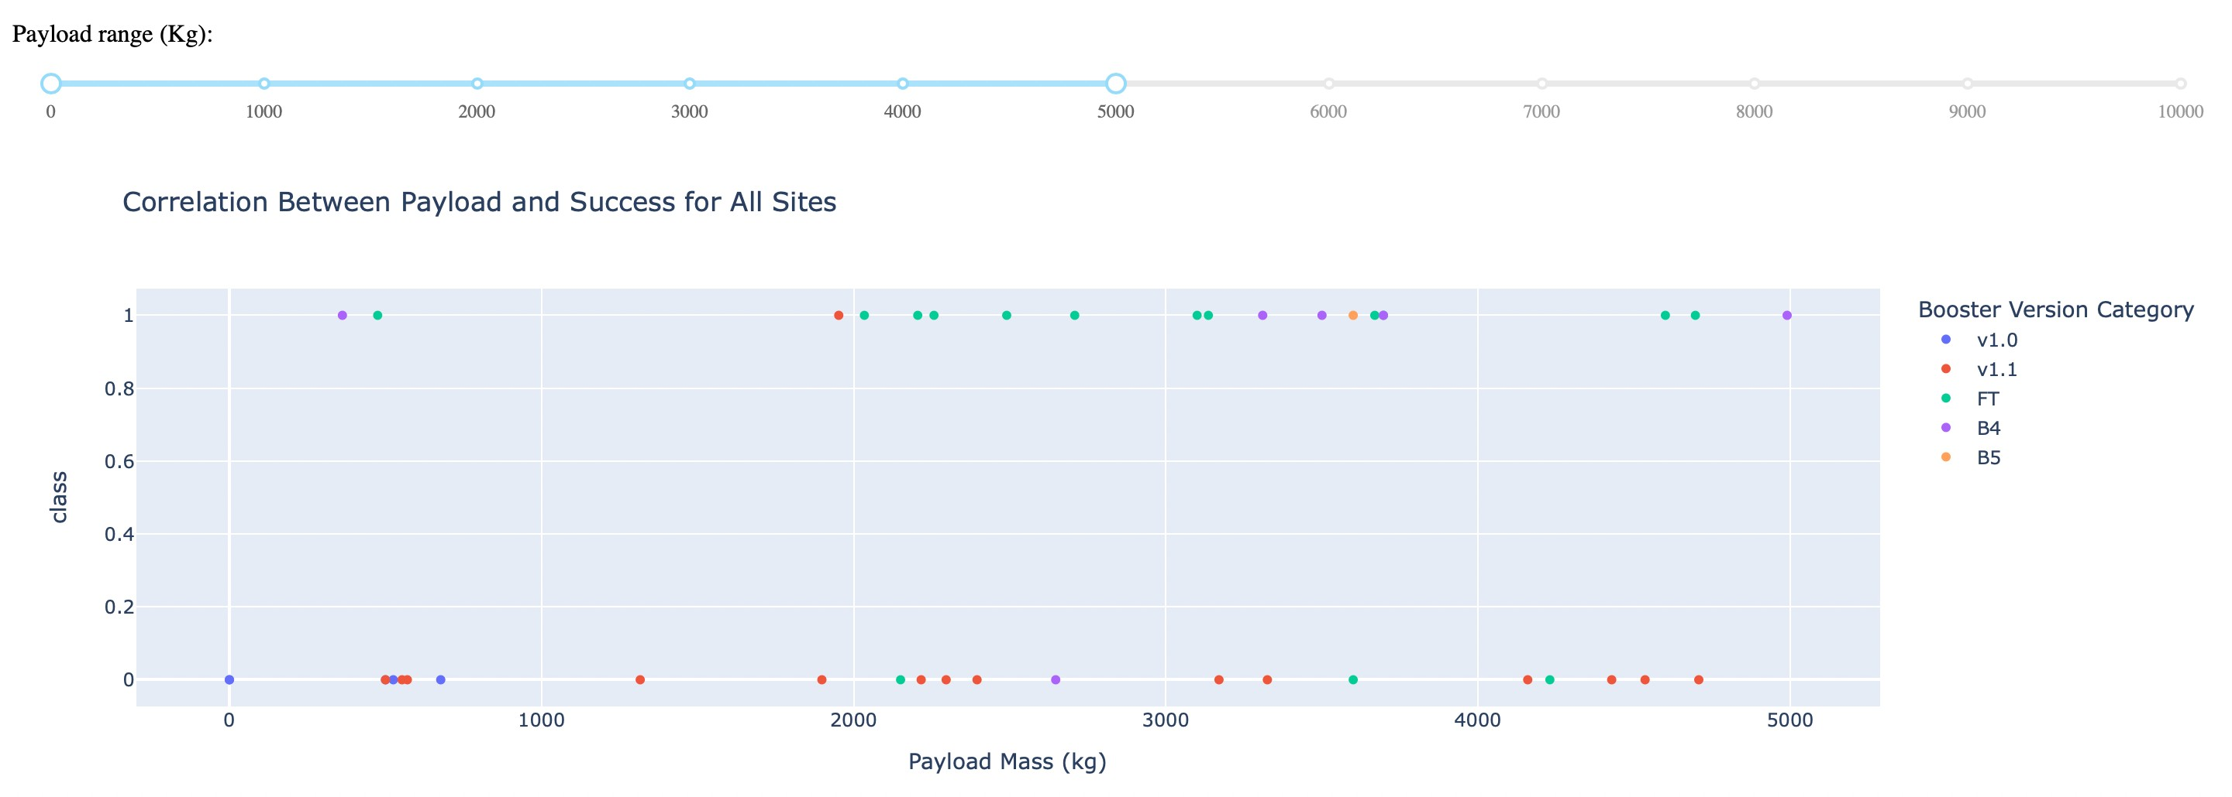
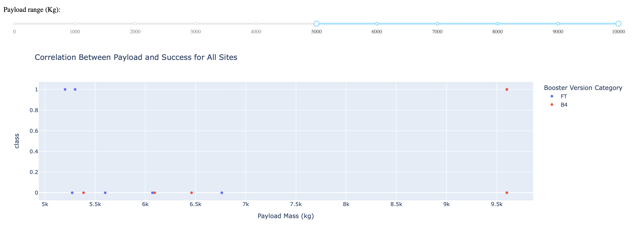
Explanation:
Payload Mass vs Success
The charts show that payloads between 2000 and 5500 kg have the highest success rate.

Slide 40
Predictive Analysis (Classification)

Slide 41
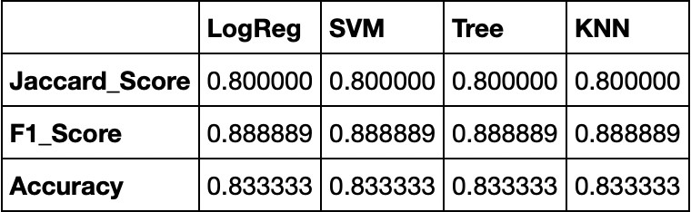
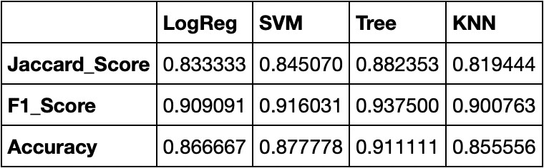
Scores and Accuracy of the Test Set
Accuracy
Explanation:
Based on the scores of the Test Set, we can not confirm which method performs best.
Same Test Set scores may be due to the small test sample size (18 samples). Therefore, we tested all methods based on the whole Dataset.
The scores of the whole Dataset confirm that the best model is the Decision Tree Model. This model has not only higher scores, but also the highest accuracy.
Scores and Accuracy of the Entire Data Set

Slide 42
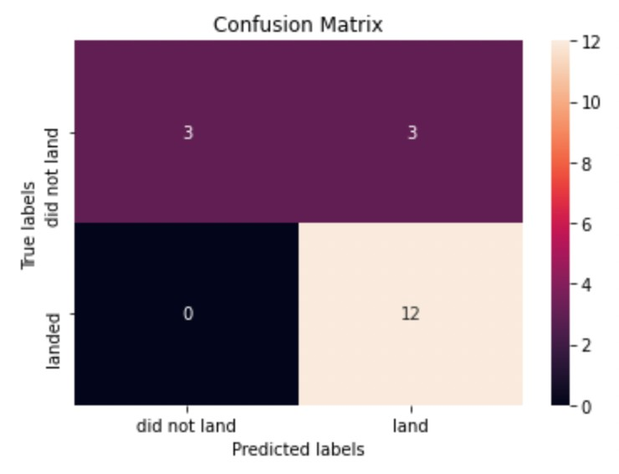
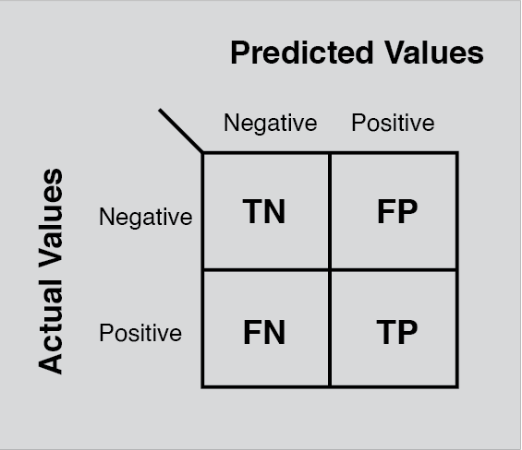
Explanation:
Confusion Matrix
Examining the confusion matrix, we see that logistic regression can distinguish between the different classes. We see that the major problem is false positives.

Slide 43

Conclusion
Decision Tree Model is the best algorithm for this dataset.
Launches with a low payload mass show better results than launches with a larger payload mass.
Most of launch sites are in proximity to the Equator line and all the sites are in very close proximity to the coast.
The success rate of launches increases over the years.
KSC LC-39A has the highest success rate of the launches from all the sites.
Orbits ES-L1, GEO, HEO and SSO have 100% success rate.

Slide 44
Special Thanks to:
Instructors Coursera IBM
Appendix

